Slide 1
CSP 571 – Data Preparation and Analysis
Spring 2024
Player Performance Analysis
Sai Manohar Vemuri (A20514848)
Yasaswini Kakumani (A20547678)

Slide 2
Table of Contents
Problem Statement
Dataset Description
Methodology
Data Preprocessing
Data Analysis
Modelling
Result Analysis
Conclusion

Slide 3
Problem Statement
Analytical Framework Development: Develop and implement a robust analytical framework to parse and interpret extensive football player data, focusing on identifying key performance indicators, categorizing players by positions and continents, and extracting valuable insights through exploratory data analysis and visualization methods.
Predictive Modeling: Utilize predictive modeling techniques to forecast player performance metrics and determine player positions, enhancing decision-making processes related to performance and providing strategic foresight for team management.
Enhanced Decision-Making: Provide football teams with actionable insights derived from the analysis, empowering them to make informed decisions at both individual and team levels for continual improvement in a fast-paced professional football environment.

Slide 4
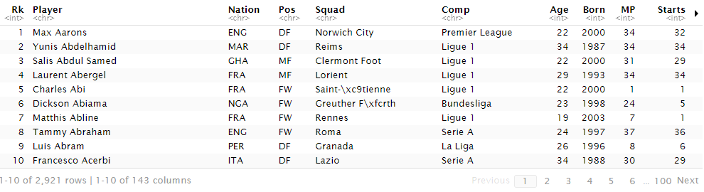
Dataset Description
Dataset: Detailed player statistics from major football leagues for the 2022-2023 season, offering personal and in-game metrics.
Analysis Goals: Identify key performance indicators, categorize players, and extract insights through data analysis and visualization.
Value Proposition: Actionable insights for teams to make informed decisions, improving performance in professional football.

Slide 5
Methodology
Data Collection and Preprocessing: Obtain comprehensive player statistics from Kaggle. Preprocess data to handle missing values, outliers, and inconsistencies.
Exploratory Data Analysis (EDA): Gain insights into data distribution and characteristics. Visualize relationships between variables and analyze player distribution across leagues and positions.
Feature Engineering and Dimensionality Reduction: Engineer meaningful metrics and apply dimensionality reduction techniques like PCA. Enhance analysis and reduce computational complexity.
Predictive Modeling: Use Random Forest and SVM to forecast player performance metrics and positions. Optimize models through hyperparameter tuning and evaluate using key metrics.

Slide 6
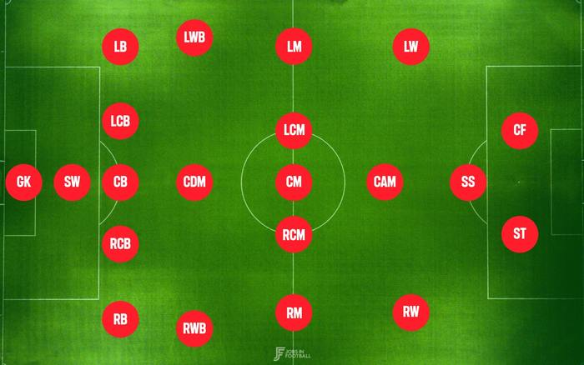
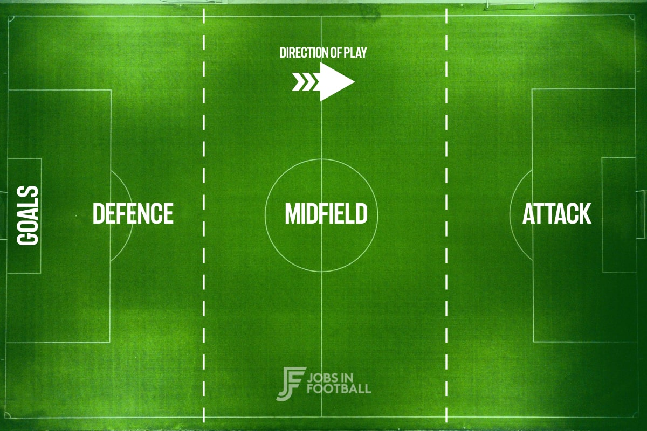
Data Preprocessing
Handling Null Values: Checked for missing values and opted to replace them with zero to avoid distorting the data. Eliminated duplicate rows to ensure data accuracy before further analysis.
Standardization and Categorization: Standardize position names for consistency and categorize players' nationalities by continent for easier analysis.
A new column, 'Age Group', was introduced to the dataset, revealing that the majority of players are under 25 years old. This underscores the sport's preference for youth, likely due to its physical demands and emphasis on athleticism.

Slide 7
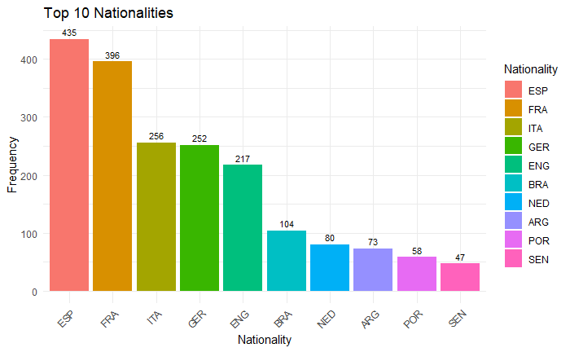
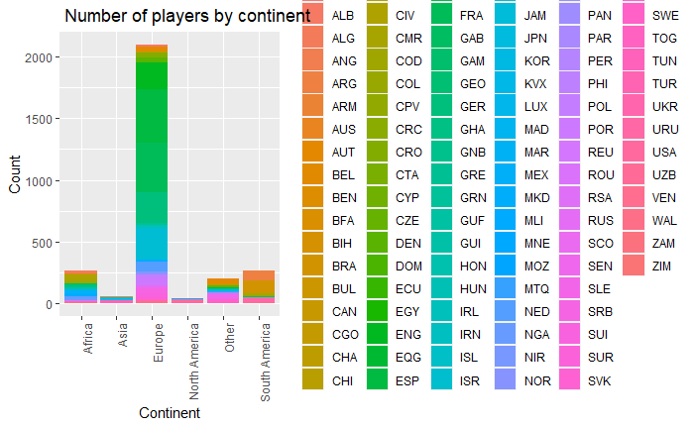
Data Analysis Player Distribution by Continent and Nationality
The below graph illustrates the number of players categorized by continents and their respective nationalities.
European players dominate the dataset, reflecting the focus on Europe-based leagues. Within Europe, nationalities such as Spain and France exhibit a strong presence, possibly influenced by factors like national league popularity and regional football traditions.
This distribution highlights the diversity of players and the global appeal of football.

Slide 8
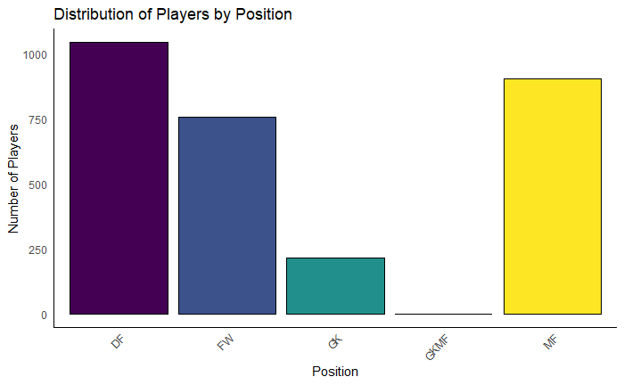
Player Distribution by Position
Defenders (DF) are the most prevalent group.
Midfielders (MF) and Forwards (FW) closely follow, with Goalkeepers (GK) being the least represented.
This distribution mirrors typical player composition in a football team, where a greater number of defenders and midfielders are often required.

Slide 9
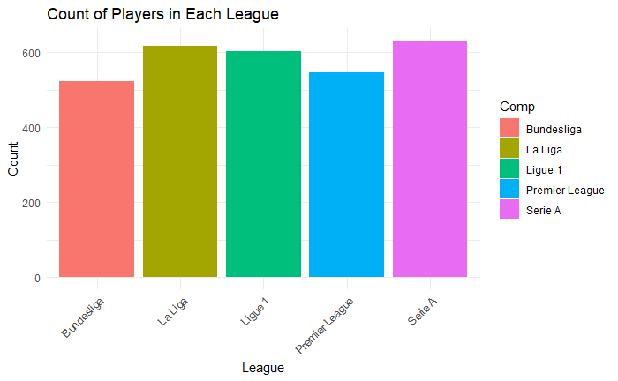
Count of Players in Each Major League
The plot displays the count of players in the five major leagues: Bundesliga, La Liga, Ligue 1, Premier League, and Serie A.
The distribution reveals a generally equal count of players across leagues, suggesting comparable scales of operation.
This balance may indicate the competitiveness and market equity of the major European leagues.

Slide 10
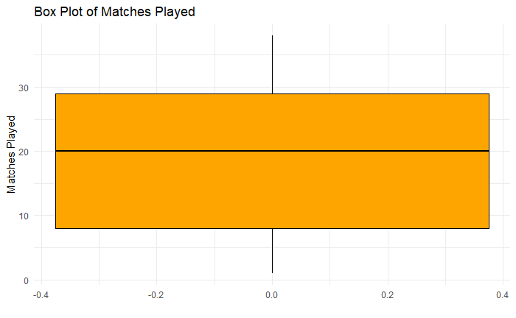
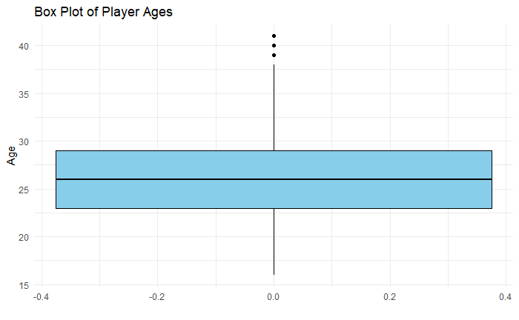
Outlier Analysis
Majority of players participate in a moderate number of matches, with outliers indicating exceptionally high or low counts.
Variation in match participation reflects differences in career longevity, injury rates, or changes in team lineups, offering insight into typical player involvement per season.
Visualizing the median, quartiles, and outliers in the age distribution provides clarity on football's age dynamics, crucial for understanding career longevity and recruitment potential.
The box plot reveals a clustering of players in their mid-to-late twenties, with outliers extending into their forties, indicating a predominant prime age range for players. Few players continue professionally beyond this age, with outliers representing seasoned players persisting in competition. Overall, the distribution suggests a relatively youthful workforce in professional football.

Slide 11
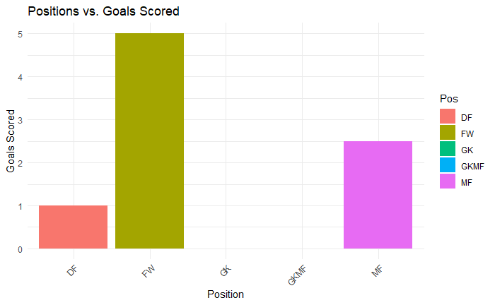
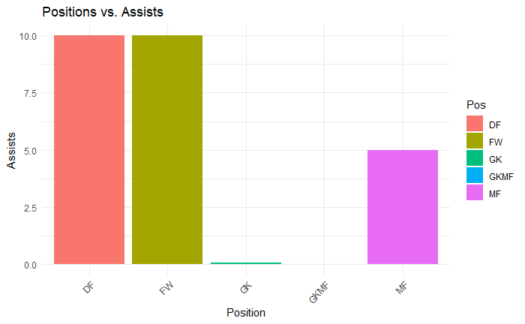
Position vs Goals Scored:
Forwards (FW) exhibit the highest average number of goals, reflecting their primary role in scoring, while midfielders (MF) also contribute significantly due to their involvement in offensive plays.
Defenders (DF) record the fewest goals, emphasizing their primary responsibility in preventing goals, with goalkeepers (GK) having the least number of goals, aligning with their minimal involvement in scoring.
Position vs Assists:
Midfielders (MF) lead in average assists, reflecting their central role in creating goal-scoring opportunities, while forwards (FW) also contribute significantly due to their involvement in offensive plays.
Defenders (DF) record fewer assists, focusing primarily on defensive duties, while goalkeepers (GK) have the fewest assists, reflecting their specialized position and limited involvement in creating scoring opportunities.

Slide 12
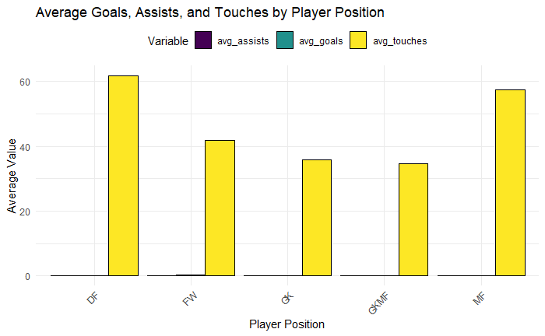
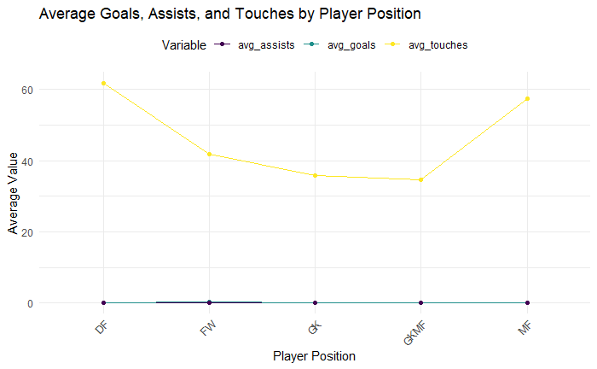
Average Goals, Assists, and Touches Per Position
Midfielders (MF) display the highest average values for assists and touches, consistent with their pivotal role in controlling the game and creating scoring opportunities.
Forwards (FW) show a notable average number of goals, reflecting their primary responsibility for scoring goals.
Defenders (DF) and goalkeepers (GK) exhibit lower goal and assist statistics, in line with their defensive positions. They also have fewer average touches compared to midfielders, indicating less frequent engagement in ball possession.
This chart offers insights into the offensive involvement and ball possession tendencies of each position during games, providing clues about teams' preferred styles of play.

Slide 13
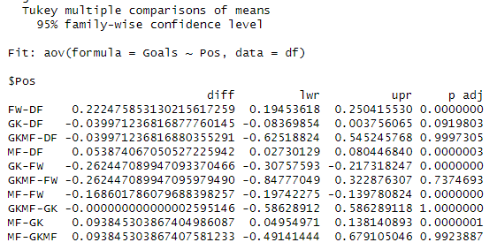
Turkey HSD (Honestly Significant Difference)
Tukey's Honestly Significant Difference (HSD) test is employed after obtaining a significant F-statistic from the ANOVA to identify precise differences between positions.
Comparisons such as FW-DF, MF-DF, and MF-GK suggest that forwards and midfielders exhibit significantly more assists than defenders and goalkeepers, respectively.
Conversely, comparisons like GK-DF, GK-FW, and MF-FW indicate that goalkeepers have fewer assists compared to defenders and forwards, and midfielders have fewer assists compared to forwards.
All p-values are extremely low (essentially zero), indicating statistically significant differences even after adjusting for multiple comparisons.

Slide 14
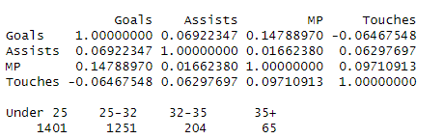
Correlation Analysis
Goals and Assists: Positive but weak correlation (r = 0.11), indicating players who score more goals tend to have slightly more assists.
Goals and Matches Played (MP): Somewhat favorable correlation (r = 0.41), suggesting players participating in more matches tend to score more goals.
Goals and Touches: Weak negative association (r = -0.14), implying possessing the ball more frequently may not increase goal-scoring likelihood.
Assists and Matches Played (MP): Moderate positive association (r = 0.41), indicating players with more assists often participate in more matches.
Assists and Touches: Nearly zero correlation (r = 0.01), suggesting no meaningful association between touches and assists.
Touches and Matches Played (MP): Very modest positive correlation (r = 0.03), indicating playing more matches does not substantially increase a player's number of touches.

Slide 15

Chi-Squared Test Insights
The chi-squared test results reveal a significant association between player positions and nationalities, indicating that certain positions may be more prevalent among specific ethnic groups.
This suggests potential cultural or training disparities in football across countries, emphasizing the diversity within the sport's global landscape and highlighting the influence of nationality on player positions.

Slide 16
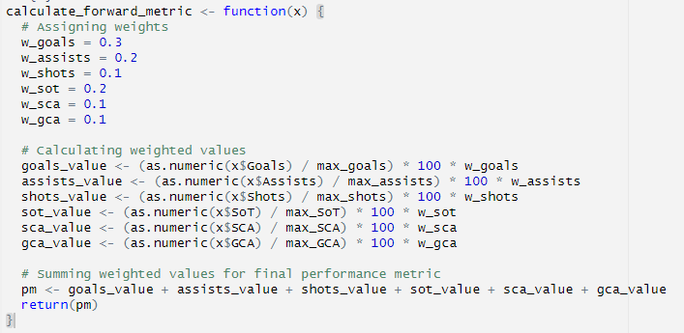
Performance Metrics Customization
Performance metrics are computed based on the player's position, with weighted significance assigned to features customized for each role: forward, defender, or midfielder.
The provided code demonstrates the differentiated weighting allocated to different features, ensuring that performance metrics effectively capture the distinct contributions and skill sets demanded by various positions in a football match.
Features included in the metrics are selected through manual analysis to encompass essential attributes most pertinent and influential for each specific role on the field, guaranteeing a unique and comprehensive evaluation of player performance based on their position.

Slide 17
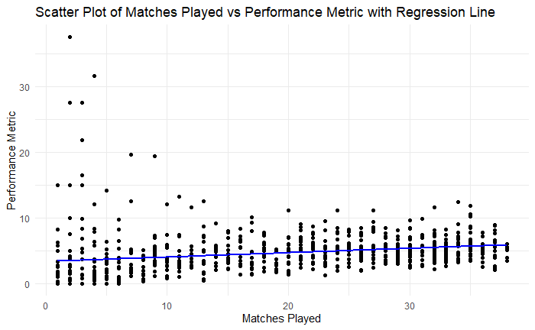
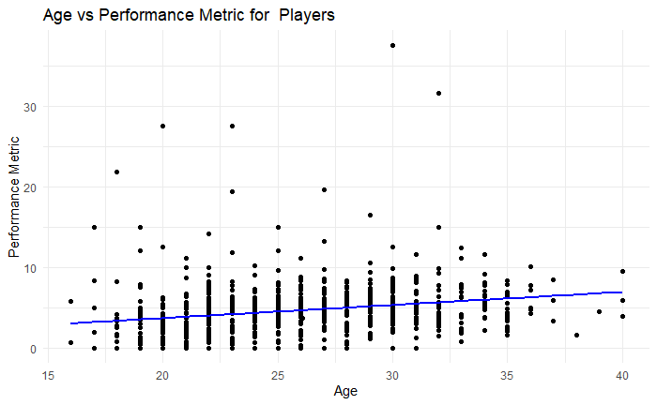
Performance Metrics
The scatter plot on left demonstrates a statistically significant yet weak relationship between age and the performance metric for players, indicated by a significant p-value.
Despite significance, the low R-squared values suggest age alone doesn't strongly predict performance, as substantial variability exists beyond age's influence. Other factors likely play significant roles, indicating the need for a multifactorial approach to performance analysis.
The scatter plot on right shows a positive relationship between matches played and performance metrics, supported by a strong F-statistic and low p-value.
However, the relatively low R-squared value suggests that other factors not included in the model also influence performance metrics.

Slide 18
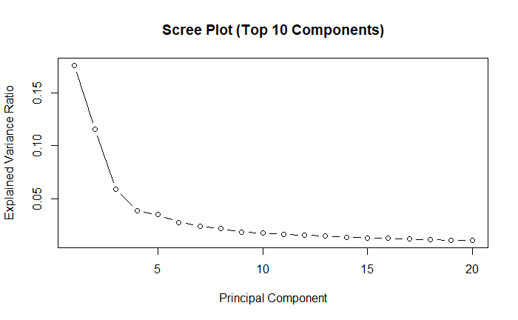
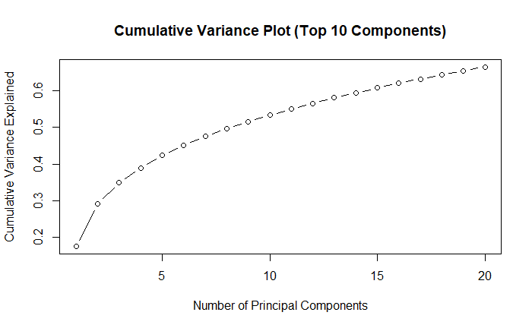
Modelling Principal Component Analysis (PCA)
Dimensionality Reduction with PCA: PCA utilized before Random Forest model to reduce features, enhancing computational efficiency, feature independence, and data visualization.
Scree Plot on the right visualizes variance explained by each principal component, aiding in identifying significant components based on curve steepness.
Cumulative Variance Ratio Plot: Represents cumulative variance ratio, indicating proportion of total variance explained by each principal component, aiding in dimensionality reduction decisions.

Slide 19
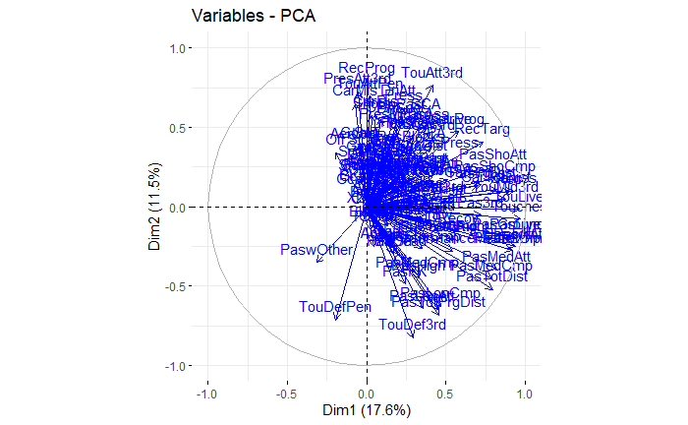
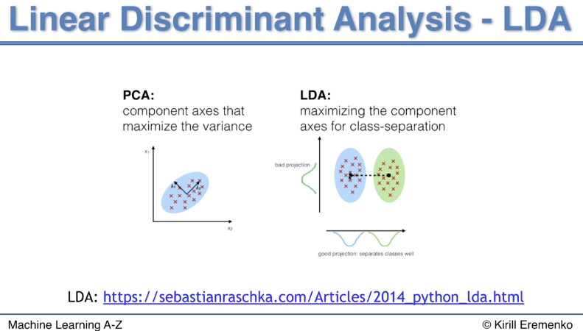
Biplot of Attributes: Allows visualization of similarities and differences between samples, illustrating attribute influence on principal components.
Linear Discriminant Analysis (LDA): Linear Discriminant Analysis (LDA) utilized to enhance classification performance by finding the linear combinations of features that best separate different classes.
LDA maximizes the separation between multiple classes while reducing dimensionality, aiding in efficient classification and visualization of data.

Slide 20
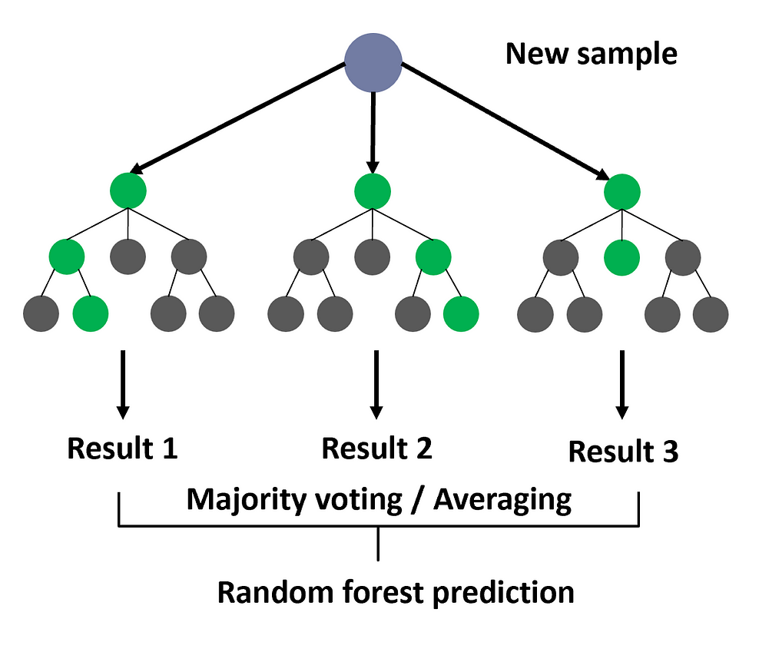
Random Forest Model
The Random Forest algorithm constructs multiple decision trees and merges their forecasts to enhance accuracy and mitigate overfitting.
It adapts by randomly selecting data and feature subsets for each tree, amalgamating predictions for a conclusive outcome.
This method is adaptable, suitable for regression and classification, and resilient to noisy data.

Slide 21
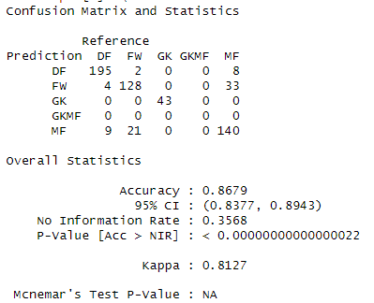
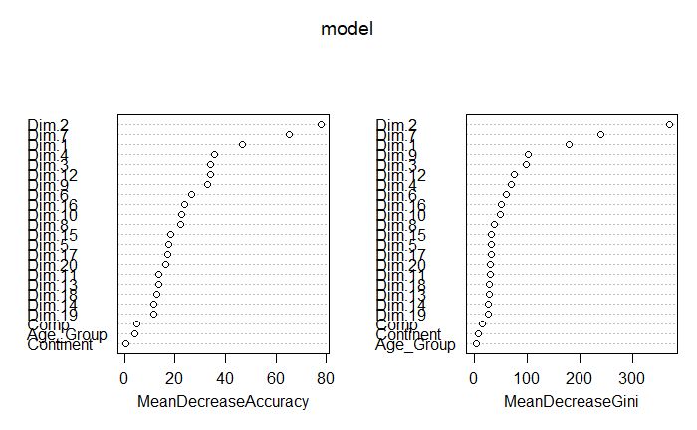
Model Test Results:
The confusion matrix indicates an overall accuracy of 86.79%, surpassing random chance (p-value < 2.2e-16), with a 95% confidence interval of approximately 83.77% to 89.43%.
The Kappa statistic of 0.8127 confirms substantial agreement between predicted and actual classifications, accounting for chance. However, misclassifications are observed for certain classes.
Variable Importance Plots: Specific features, particularly Dim.2, Dim.9, and Dim.1, are highlighted as critical to the model's performance, exhibiting high Mean Decrease in Accuracy and Gini values

Slide 22
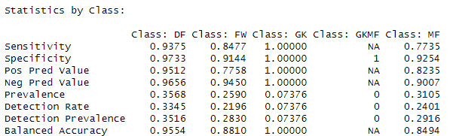
The Random Forest model achieves an accuracy of 86.79% (95% CI: 83.77% - 89.43%) and a Kappa value of 0.8127, indicating substantial agreement with actual labels.
Sensitivity ranges from 0.7735 to 1.0000, and specificity ranges from 0.9144 to 1.0000 across classes, demonstrating the model's ability to correctly identify positive and negative instances.
Class GKMF lacks predictions due to insufficient data, suggesting further optimization to address class imbalance and enhance overall performance.

Slide 23
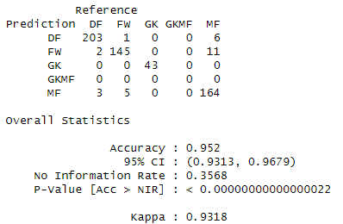
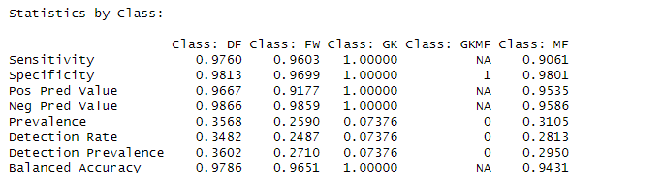
Random Forest using Linear Discriminant Analysis (LDA)
Accuracy: 95.20% (95% CI: 93.13% - 96.79%)
Kappa Value: 0.9318
Sensitivity: 0.9061 to 1.0000
Specificity: 0.9699 to 1.0000
Model demonstrates substantial agreement with actual labels and accurately identifies positive and negative instances across classes.
Absence of predictions for class GKMF persists due to insufficient data.
Mean Decrease Accuracy and Mean Decrease Gini values highlight predictor importance, offering insights for further optimization.

Slide 24
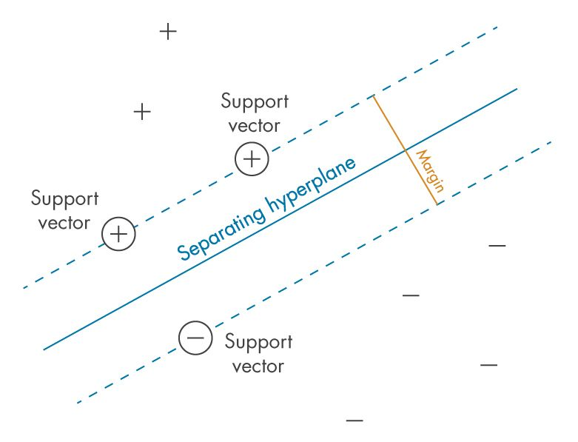
Support Vector Machine (SVM)
Support Vector Machine (SVM) is a supervised machine learning algorithm used for classification and regression tasks.
It finds the hyperplane that best separates classes in the feature space, maximizing margin between classes while minimizing classification errors.
SVM can handle non-linear separable data using kernel functions to map features into higher-dimensional space.

Slide 25
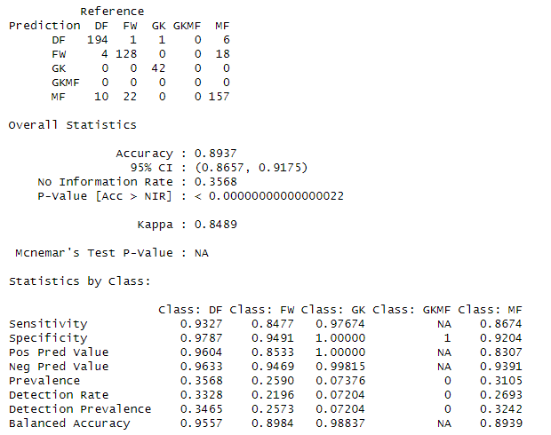
Model Test Results
SVM model achieves an accuracy of 89.37% (95% CI: 86.57% - 91.75%) and a Kappa statistic of 0.8489, indicating substantial agreement with actual labels.
Sensitivity, specificity, positive predictive values, and negative predictive values are high across most classes, demonstrating the model's effectiveness.
Class GKMF continues to have no predictions due to insufficient data.
Overall, the model demonstrates improved performance with balanced accuracy ranging from 0.8939 to 0.9557. However, further refinement is needed to address class imbalance and enhance overall effectiveness.

Slide 26
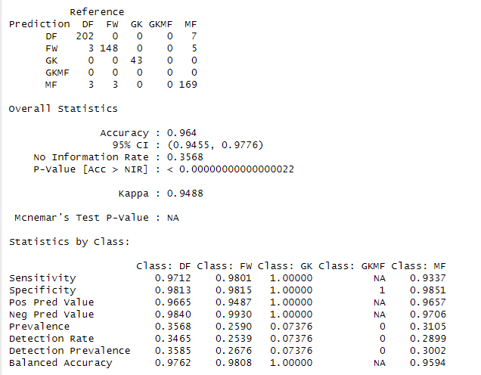
Support Vector Machine with Linear Discriminant Analysis (LDA)
Accuracy: 96.40% (95% CI: 94.55% - 97.76%)
Kappa Value: 0.9488
Sensitivity: 0.9337 to 1.0000
Specificity: 0.9815 to 1.0000
Model demonstrates substantial agreement with actual labels and robustness in correctly identifying positive and negative instances.
Absence of predictions for class GKMF persists due to insufficient data.
SVM with LDA model shows excellent performance, with potential for further investigation into feature importance and optimization.

Slide 27
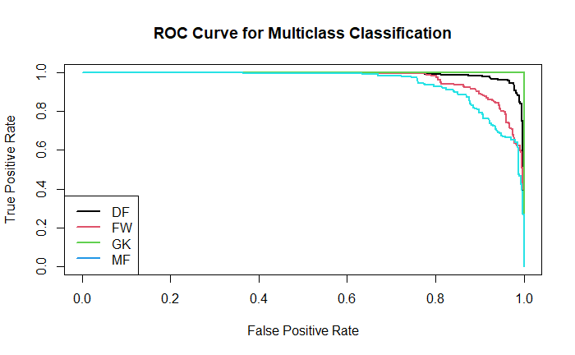
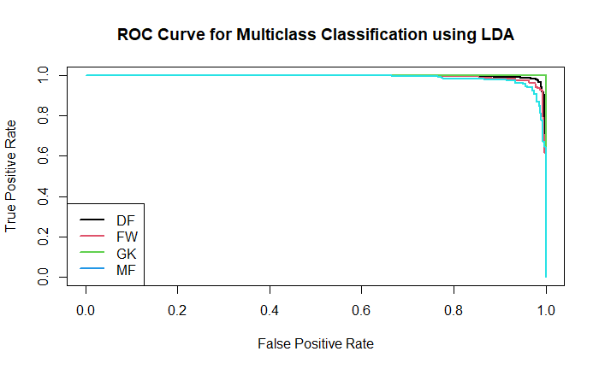
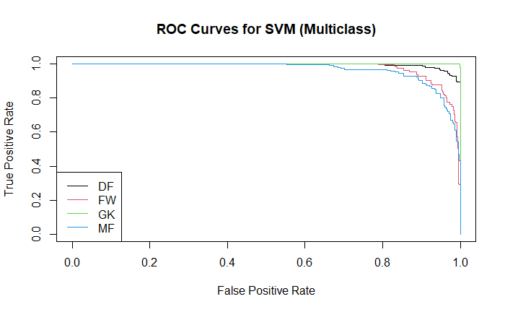
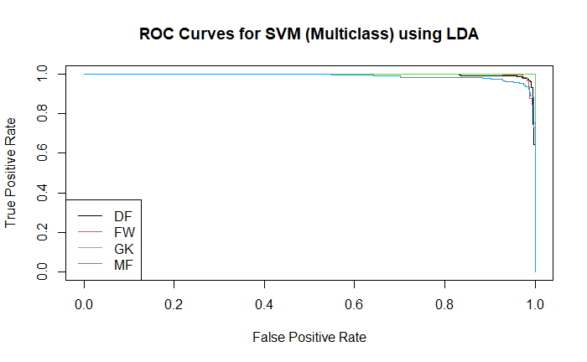
Result Analysis

Slide 28
Conclusion
Meticulous analysis of football player statistics revealed crucial positional features and age-match experience dynamics.
SVM and LDA models showcased remarkable accuracy:
SVM: 96.40% accuracy, Kappa 0.9488
LDA: 95.20% accuracy, Kappa 0.9318
Random Forest and PCA models performed slightly lower.
Dataset imbalance highlights the need for alternative methodologies.
Positive correlation between age and match experience noted, alongside the prevalence of European players.
Further research required to refine models and leverage data for strategic football management.

Slide 29
References:
Chazan-Pantzalis, Victor & Tjortjis, Christos. (2020). Sports Analytics for Football League Table and Player Performance Prediction.
https://rpubs.com/HassanOUKHOUYA/NBA_Player_Performance_Analysis_PCA_Hierarchical_Clustering_and_K-Means_Clustering
Pariath, Richard & Shah, Shailin & Surve, Aditya & Mittal, Jayashri. (2018). Player Performance Prediction in Football Game. 1148-1153. 10.1109/ICECA.2018.8474750.
Dataset Source:
https://www.kaggle.com/datasets/vivovinco/20212022-football-player-stats

Slide 30
THANK YOU

